Slide 1
Executive Sales Performance Dashboard
Sales & Profit Analysis using Tableau
Task 4: Dashboard Design
Date:17/02/2026
Presented By: Kalvacherla Reethika

Slide 2
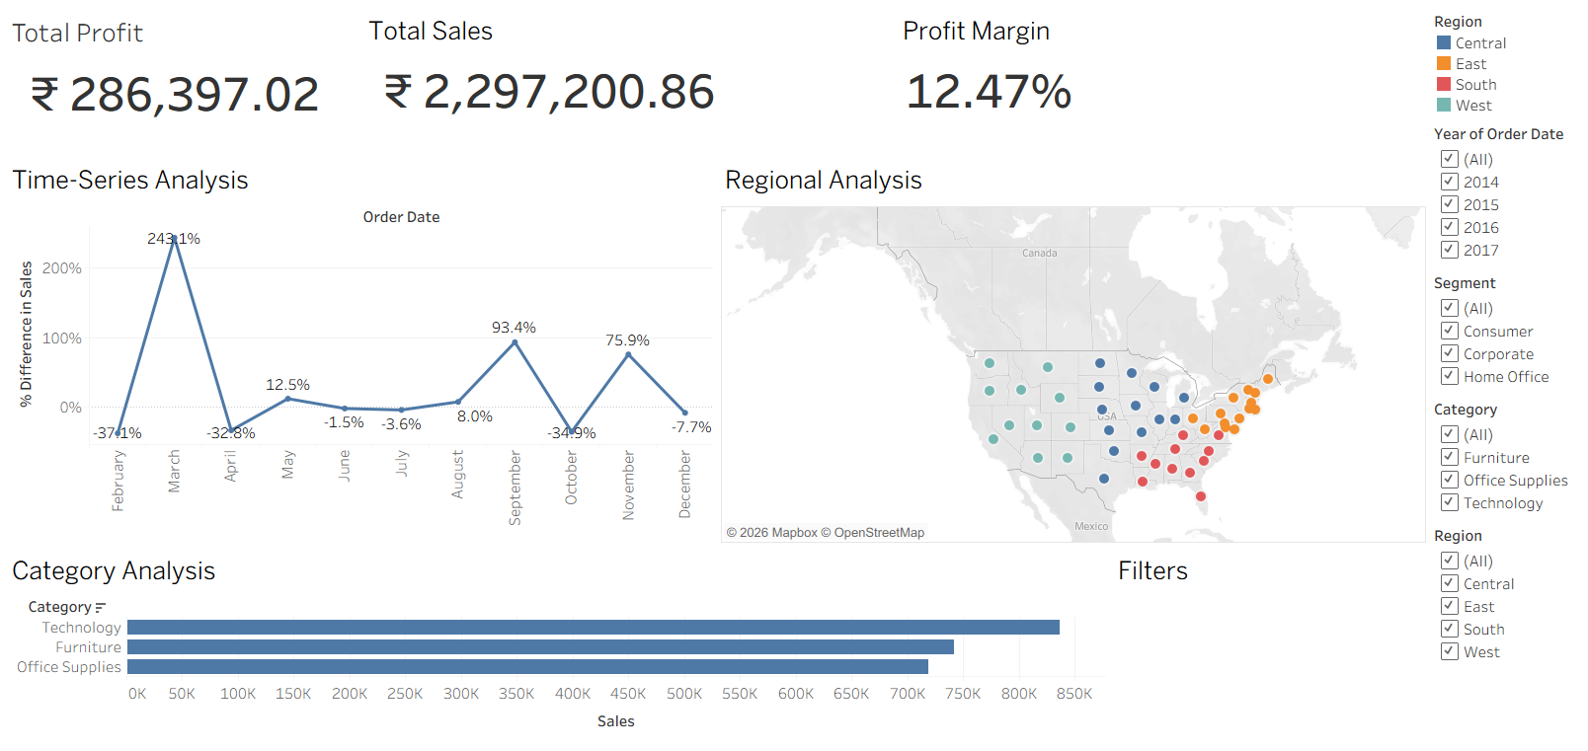
DASHBOARD

Slide 3
Project Overview
Objective
Design an interactive dashboard for business stakeholders.
Dataset: Superstore Sales dataset (Kaggle source)
Tools Used: Tableau

Slide 4
Key Metrics and KPIs
Total Sales: ₹ 22,97,201
• Total Profit: ₹ 2,86,397
• Profit Margin: 12.46%
The business generated ₹22.9L in revenue with a healthy profit margin of 12.46%

Slide 5
Time-Series Analysis
• Monthly Sales Trend (2014–2017)
• Highest growth month showed 243% increase
• Some months showed decline (e.g., -37%)

Slide 6
Regional Analysis
Sales by Region:
• West: Highest performing region
• East: Strong performance
• Central & South: Moderate performance
West region contributes the highest revenue.

Slide 7
Category Performance
Sales by Category:
• Technology: Highest sales contributor
• Furniture: Moderate sales
• Office Supplies: Stable performance
Technology category drives maximum revenue.

Slide 8
Interactive Filters
Filters included:
• Year (2014–2017)
• Region
• Category
• Segment
Users can dynamically analyze performance by selecting specific criteria.

Slide 9
Business Insights
• Strong revenue generation with 12.46% profitability
• Technology & West region are key drivers
• Growth fluctuates month-to-month
• Some regions/categories need improvement

Slide 10
Thank You

